Slide 1
DIFFERENT DISTRIBUTION

Slide 2
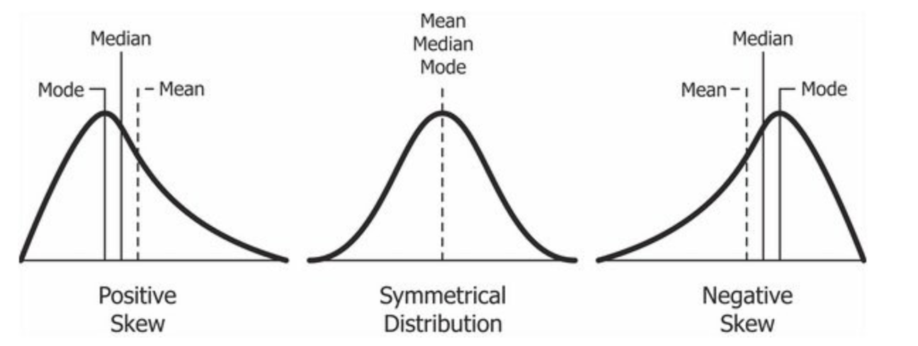
SKEWED DATA:
Data can be “Skewed”, meaning it tends to have a long tail on one side or the other .

Slide 3
Normal distribution:
Early statisticians noticed the same shape coming up over and over again in different distributions—so they named it the normal distribution.
The Normal distribution has no skew.
Normal distributions have the following features:
symmetric bell shape
mean and median are equal; both located at the center of the distribution
\approx68\%≈68%approximately equals, 68, percent of the data falls within 111 standard deviation of the mean
\approx95\%≈95%approximately equals, 95, percent of the data falls within 222 standard deviations of the mean
\approx99.7\%≈99.7%approximately equals, 99, point, 7, percent of the data falls within 333 standard deviations of the mean.

Slide 4
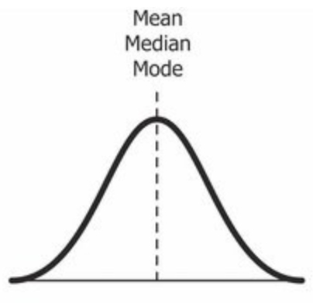
Normal distribution:

Slide 5
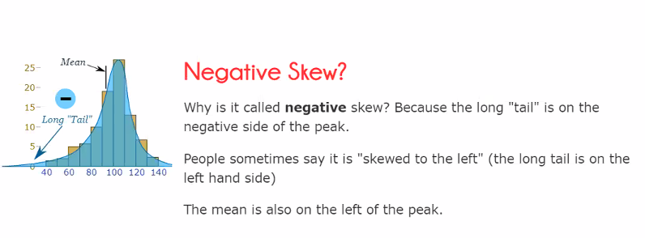
NEGATIVE SKEW:

Slide 6

Bernoulli Distribution
A Bernoulli distribution has only two possible outcomes, namely 1 (success) and 0 (failure), and a single trial. So the random variable X which has a Bernoulli distribution can take value 1 with the probability of success, say p, and the value 0 with the probability of failure, say q or 1-p.

Slide 7
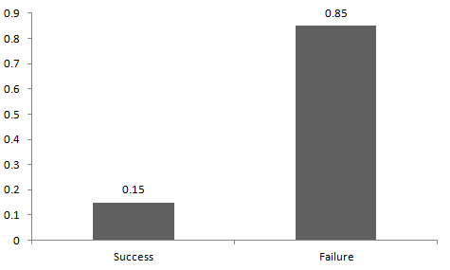
Bernoulli Distribution

Slide 8
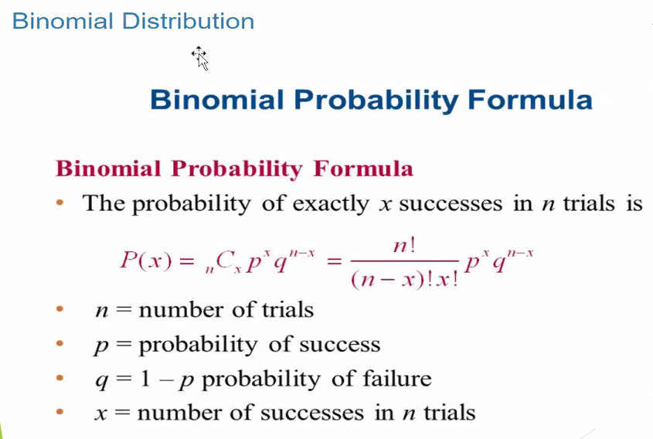
BINOMIAL PROBABILITY:

Slide 9
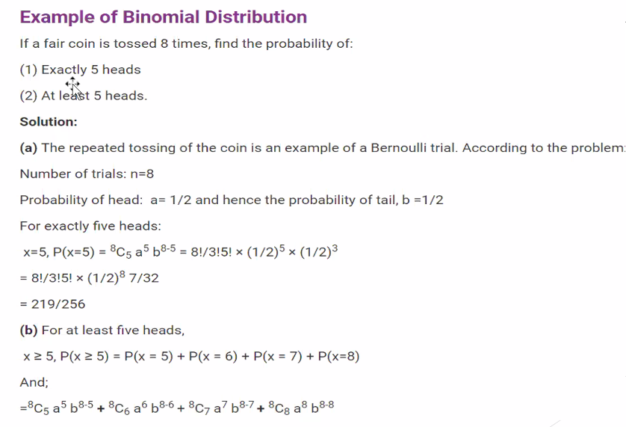
BINOMIAL PROBABILITY:

Slide 10
THE EMPERICAL RULE:
The empirical rule, also referred to as the three-sigma rule or 68-95-99.7 rule, is a statistical rule which states that for a normal distribution, almost all observed data will fall within three standard deviations (denoted by σ) of the mean or average (denoted by µ).
The Empirical Rule states that 99.7% of data observed following a normal distribution lies within 3 standard deviations of the mean.
Under this rule, 68% of the data falls within one standard deviation, 95% percent within two standard deviations, and 99.7% within three standard deviations from the mean.
Three-sigma limits that follow the Empirical Rule are used to set the upper and lower control limits in statistical quality control charts and in risk analysis such as VaR.

Slide 11
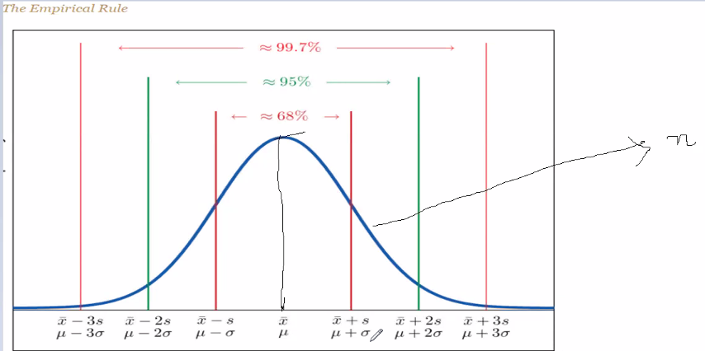
THE EMPERICAL RULE:

Slide 12
Chebyshev’s Theorem
The Empirical Rule does not apply to all data sets, only to those that are bell-shaped, and even then is stated in terms of approximations. A result that applies to every data set is known as Chebyshev’s Theorem.
For any numerical data set,
at least 3/4 of the data lie within two standard deviations of the mean, that is, in the interval with endpoints x¯±2s for samples and with endpoints μ±2σ for populations;
at least 8/9 of the data lie within three standard deviations of the mean, that is, in the interval with endpoints x¯±3s for samples and with endpoints μ±3σ for populations;
at least 1−1/k2 of the data lie within k standard deviations of the mean, that is, in the interval with endpoints x¯±ks for samples and with endpoints μ±kσ for populations,
where k is any positive whole number that is greater than 1 .

Slide 13
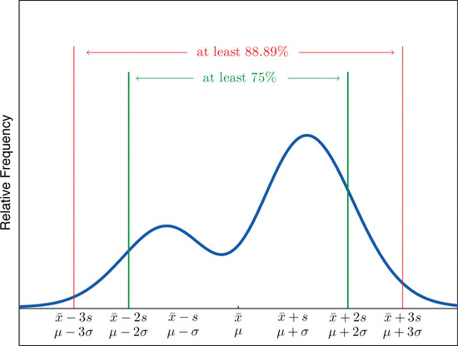
Chebyshev’s Theorem

Slide 14
